Slide 1
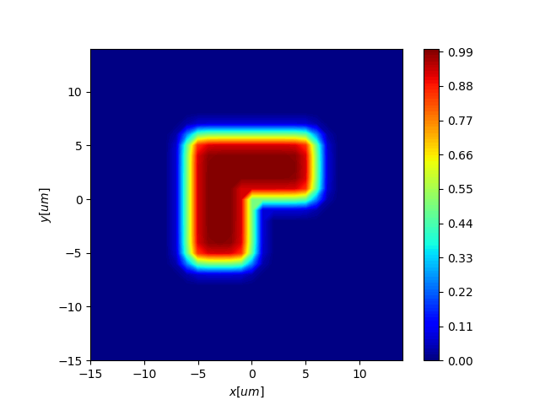
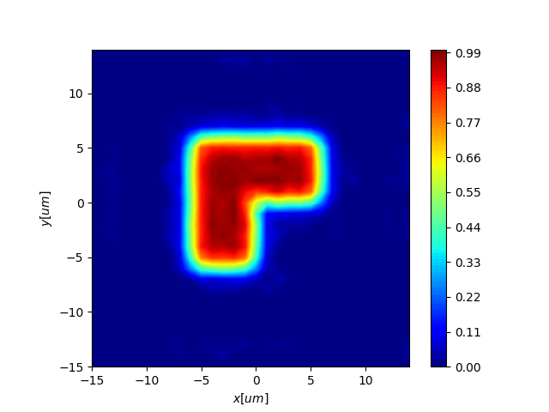
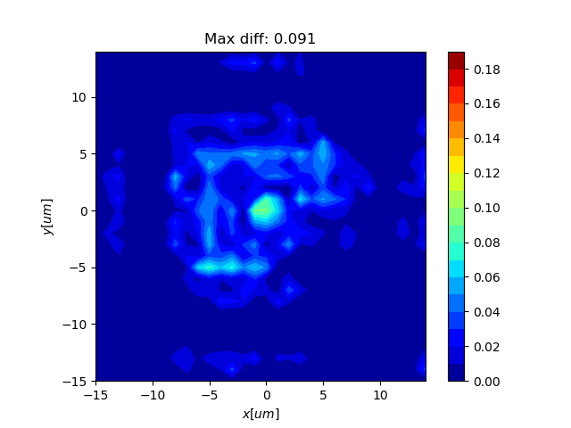
L-shape pixel
Original profile
Reconstructed profile
Difference

Slide 2
Performance of the ONERA reconstruction algorithm
INTRAPIX project
02/10/2018

Slide 3
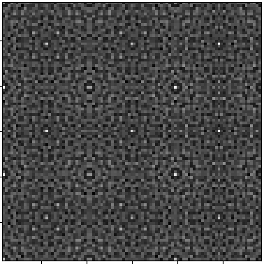
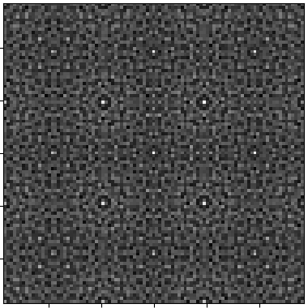
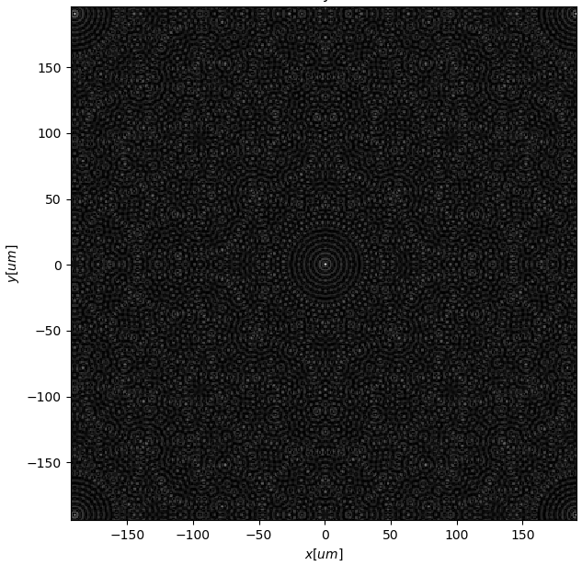
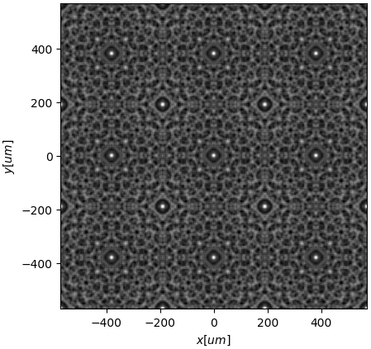
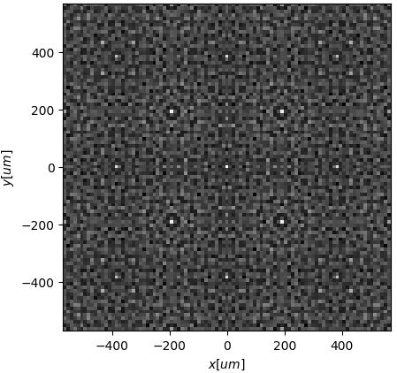
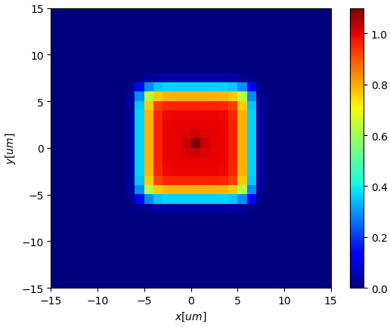
Simulation of the experimental interferogram
CSIG polychromatic PSF
Interferogram
Convolution
CSIG
translation…
Pixel profile
Pinhole
profile
Adding random noise
Interferogram seen by
the detector (undersampled)

Slide 4
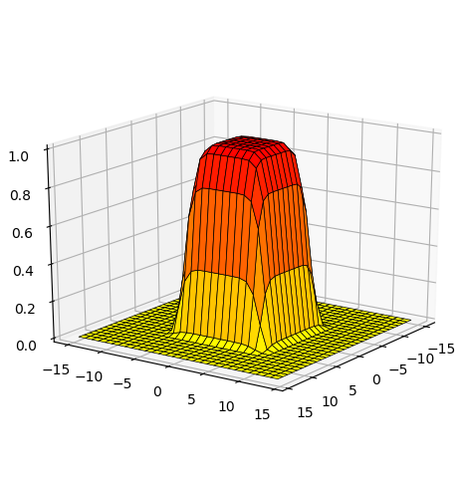

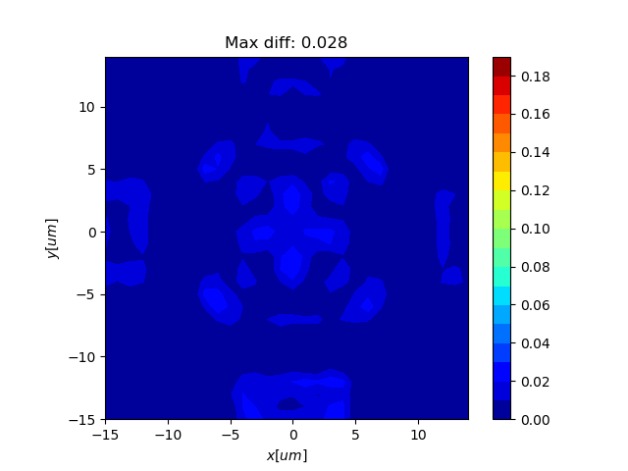
Squared Pixel
a₀ = 380 μm
Original
Reconstructed
Absolute difference

Slide 5
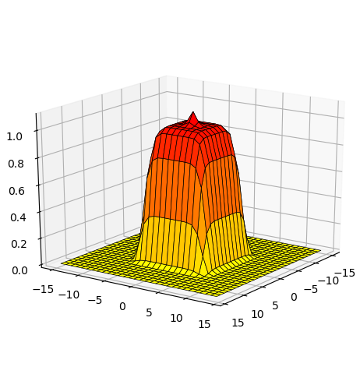


Squared Pixel with defect
a₀ = 380 μm
Original
Reconstructed
Absolute difference

Slide 6
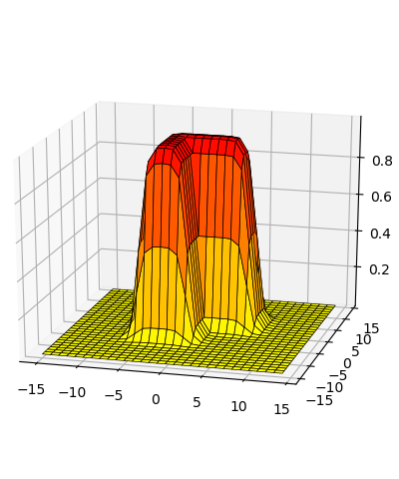
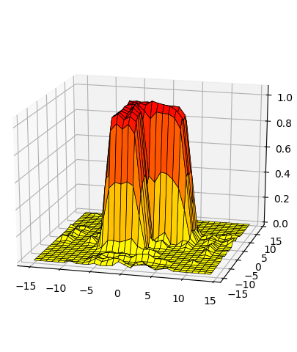
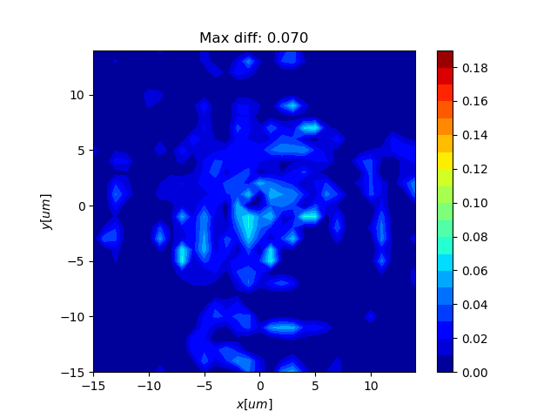
L-shape pixel
a₀ = 380 μm
Original
Reconstructed
Absolute difference

Slide 7
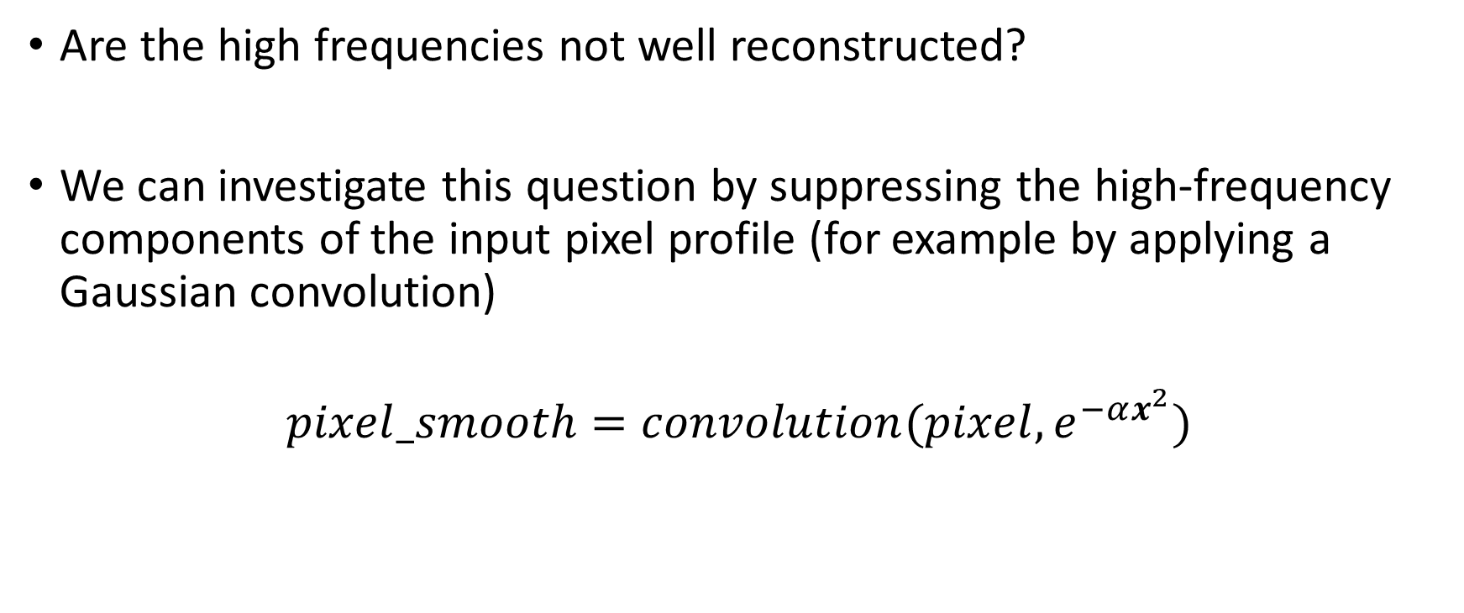
Question…
Are the high frequencies not well reconstructed?
We can investigate this question by suppressing the high-frequency components of the input pixel profile (for example by applying a Gaussian convolution)
$$pixel_smooth=convolution(pixel, e^{−αx^{2}})$$

Slide 8
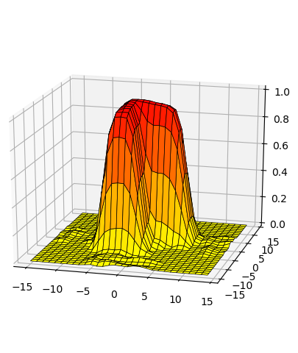

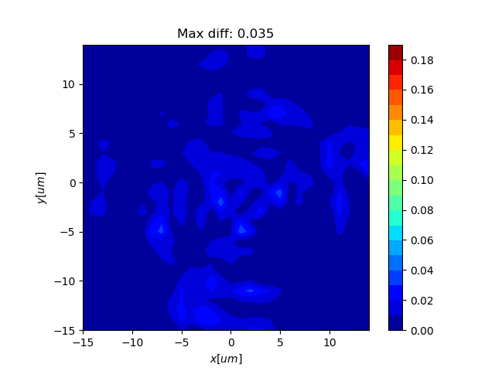
L-shape pixel
a₀ = 380 μm
smooth: α = 0.8
→ σ = 0.79 μm
Original
Reconstructed
Absolute difference

Slide 9
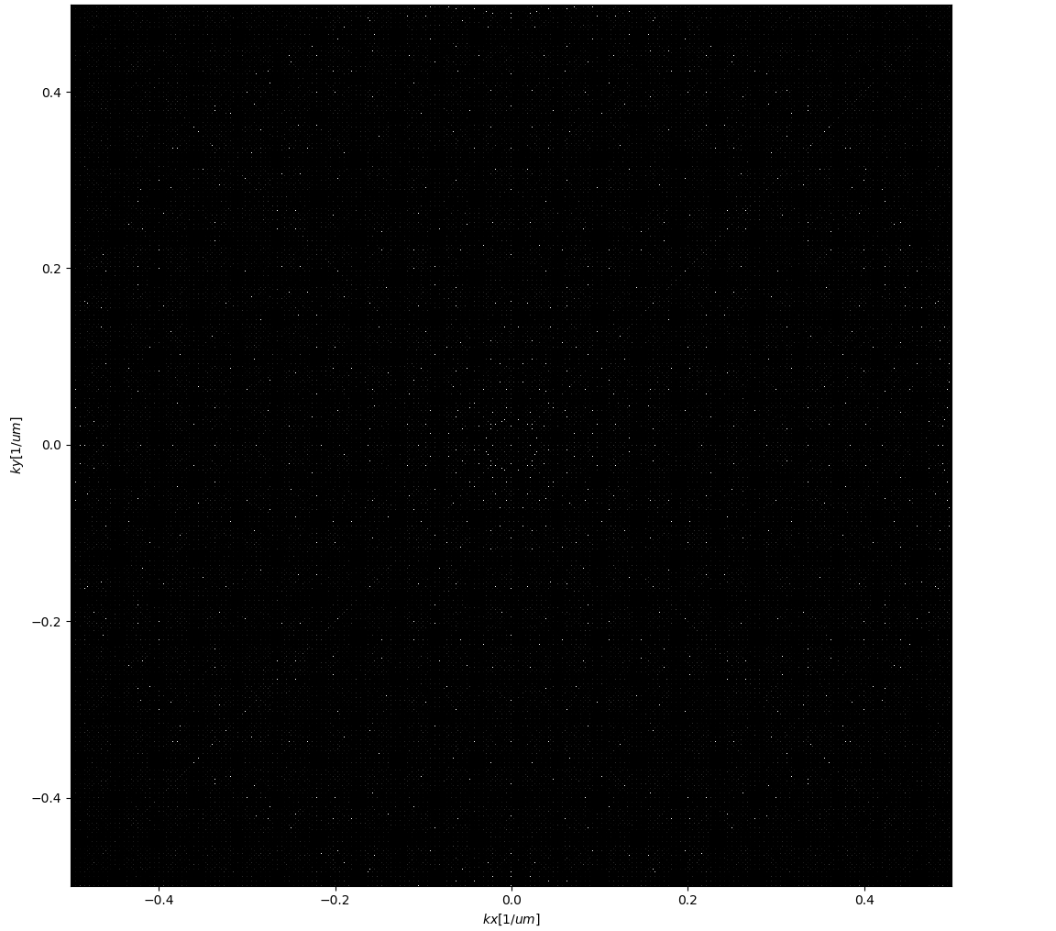
In the Fourier domain…
Looking at the Module Transfer Function …
ν_{c} = 2η / a₀ = 0.5104 μm⁻¹
but the sampling operation introduce a practical limitation:
ν < M / 2 * p_{sampling} = 0.5 μm⁻¹

Slide 10
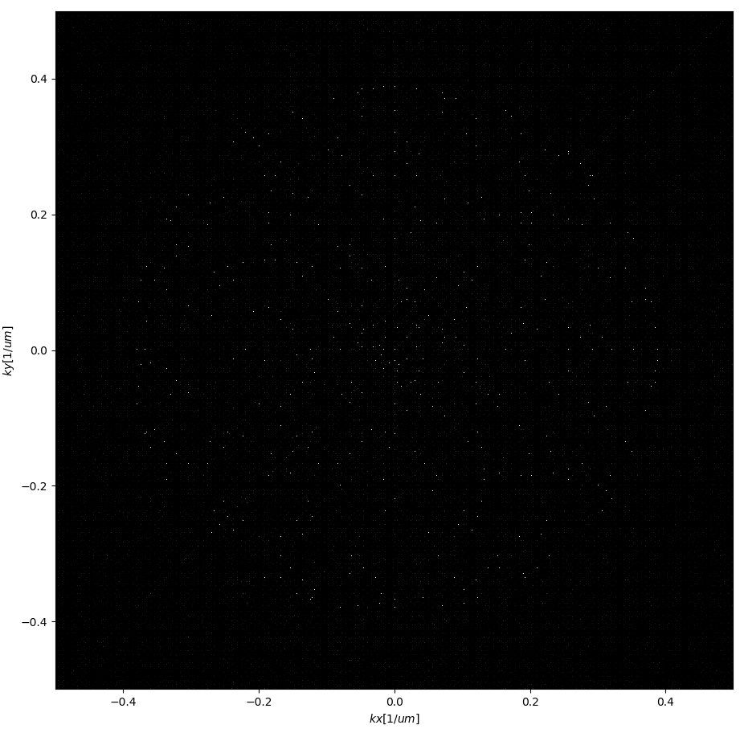
Possible investigation
Since the frequency domain cannot be extended, the CSIG Module Spread Function can be shrunk.
We can take for example a₀ = 500 μm

Slide 11
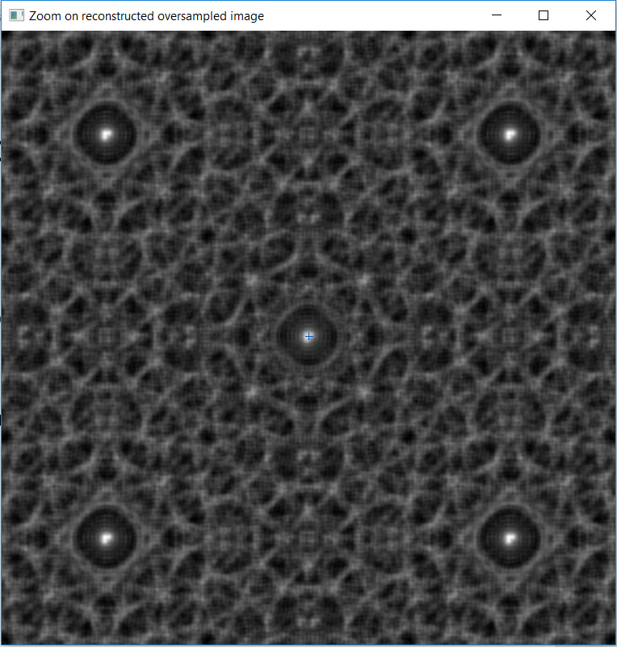
… and relative limitation
However, the comparison with not be straightforward. The ONERA reconstruction algorithm seems considering a PSF-region fixed to 2 x 380 μm. In the case of 500 μm, it corresponds to about only 1.5 of the fundamental PSF pattern…

Slide 12
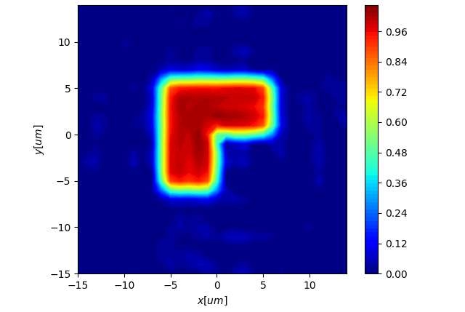
L-shape pixel
No smoothing
a₀ = 380 μm
a₀ = 500 μm

Slide 13
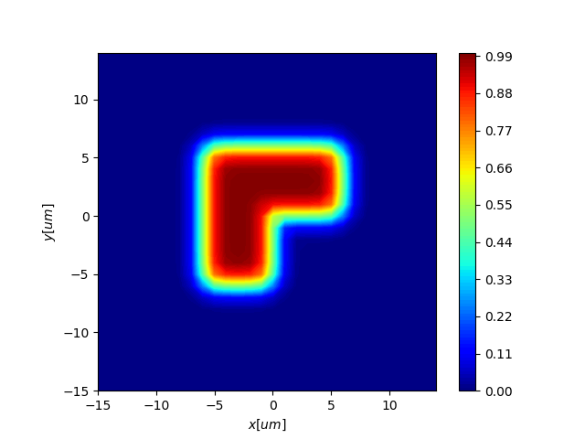
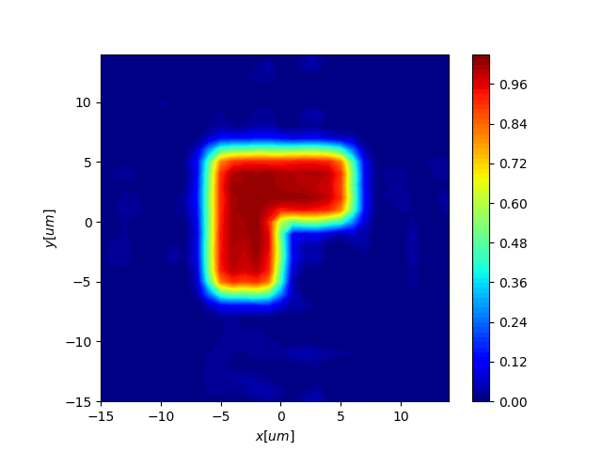
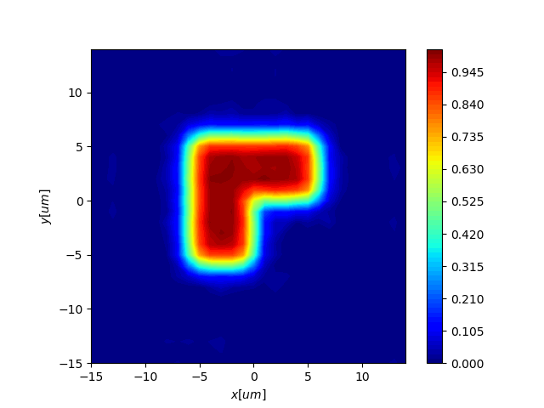
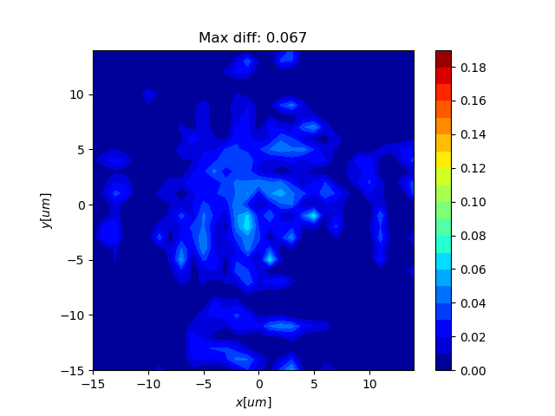
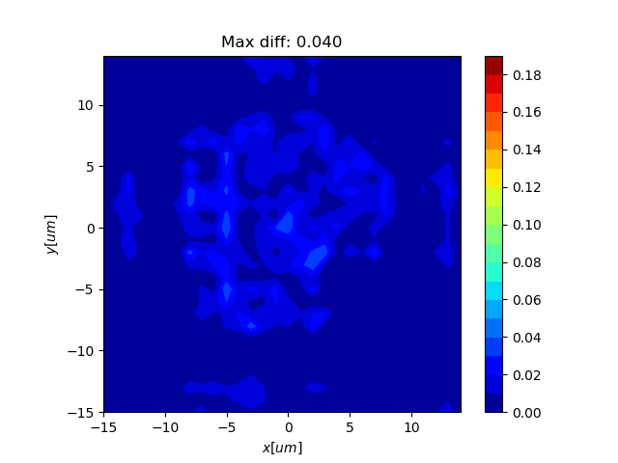
L-shape pixel
smooth: α = 2
→ σ = 0.5 μm
a₀ = 380 μm
a₀ = 500 μm

Slide 14
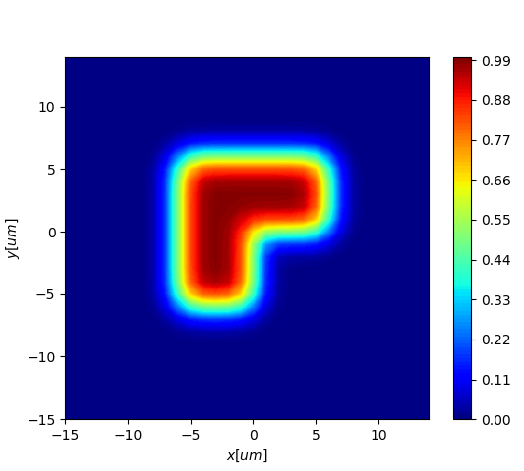
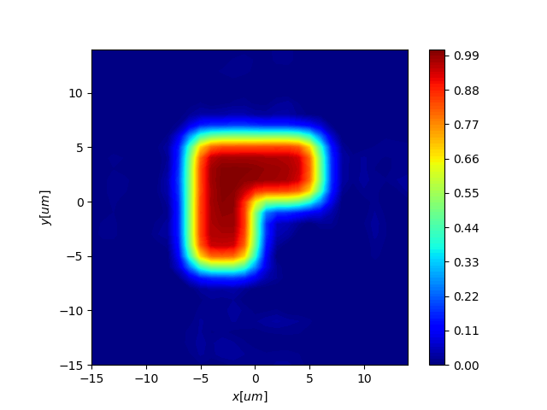

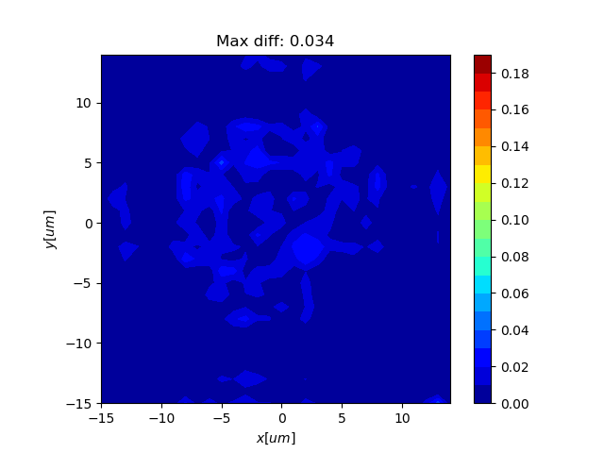
L-shape pixel
smooth: α = 0.8
→ σ = 0.79 μm
a₀ = 380 μm
a₀ = 500 μm

Slide 15
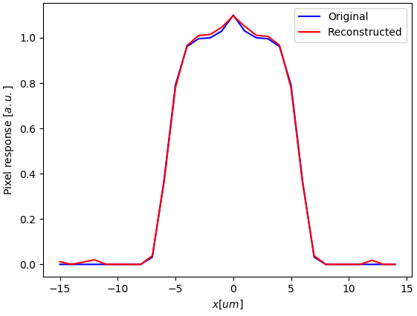
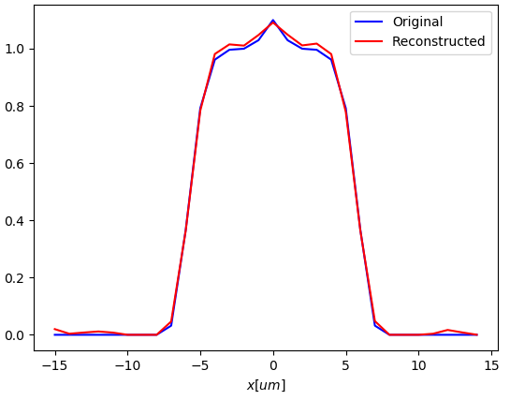
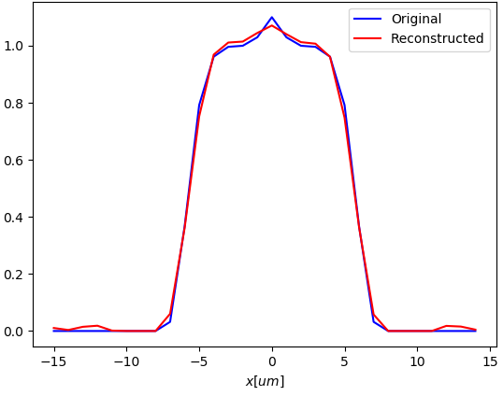
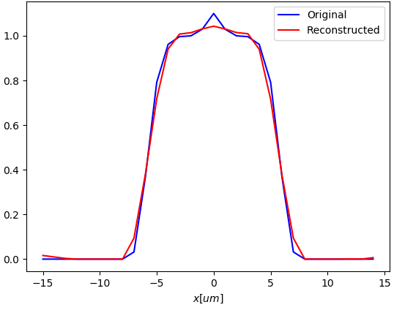
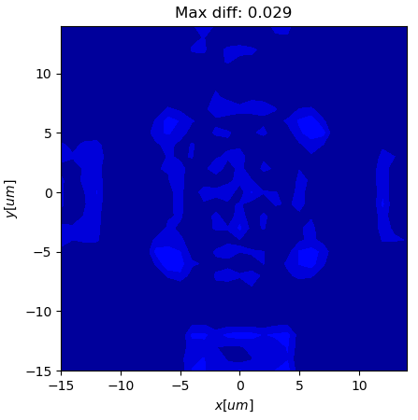

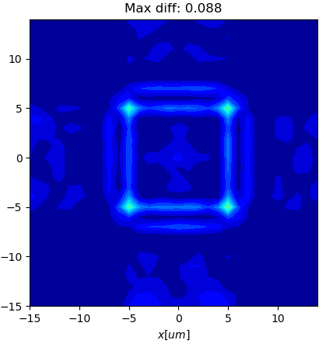
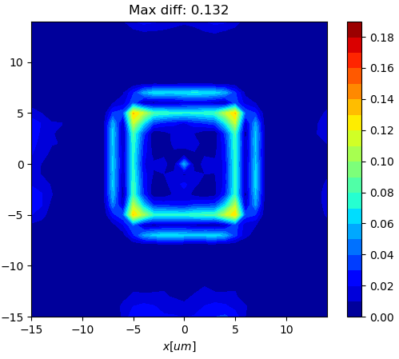
Signal-to-noise ratio performance
snr = 500
snr = 250
snr = 180
snr = 100

